Slide 1
Applying ML to House Prices in Ames
Shameer Sukha

Slide 2
Data Science Lifecycle
1) Business understanding
2) Data mining
3) Data cleaning
4) Data exploration
5) Feature engineering
6) Predictive modelling
7) Present insights

Slide 3
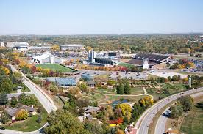
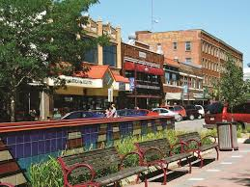

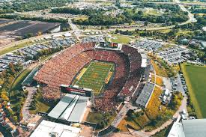


1) Business understanding
Top 100 best places to live
Iowa State University town
Academic, sports, culture
Public parks, open spaces
Good healthcare and jobs
Young population
What about real estate in Ames?
Classic case to apply supervised machine learning

Slide 4
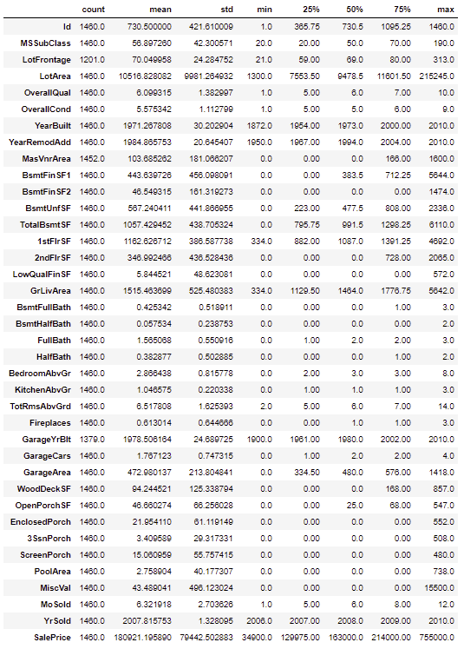
2) Data mining
No need to mine housing data
Kaggle competition
1460 datapoints
79 features
Data types
Categorical
Nominal
- Neighbourhood
- Type of material/condition
Ordinal
- Quality of house
- Quality of finish
Numerical
- Size (area sq. ft)
- No. of rooms

Slide 5
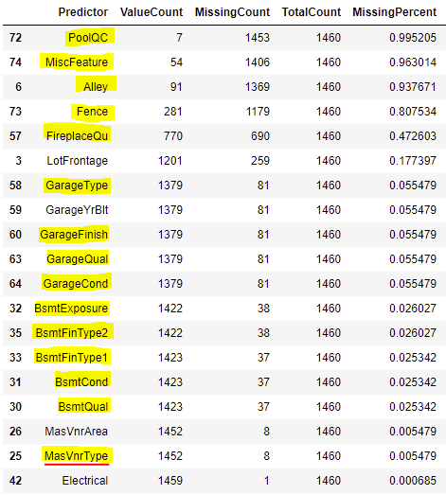
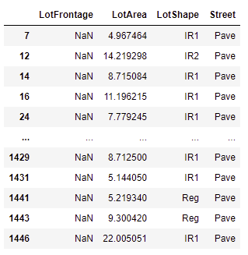
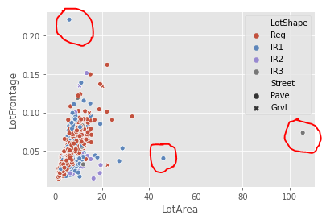

3) Data cleaning : missing data or errors
Most missing data were Not Missing At Random (NMAR)
Missing because of lack of feature
Highlighted in yellow
Impute with ‘N’
Except MasVnrType (red underline): impute with ‘None’
MasVnrArea
NMAR since houses with MasVnrType = ‘None’ are missing
Impute with 0
Electrical:
Impute ‘Mix’ since only 1 data point missing and won’t be material
LotFrontage:
Appears to be Missing At Random (MAR)
Related to LotArea (which is complete)
Use KNN imputation with k = 35 since outliers are present
BsmtExposure:
Change ‘N’ to ‘No’ since ‘N’ and ‘No’ mean different things

Slide 6
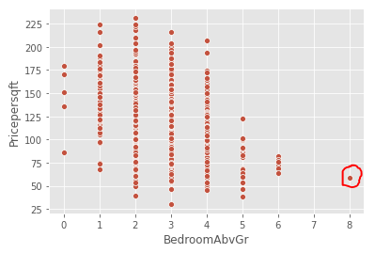
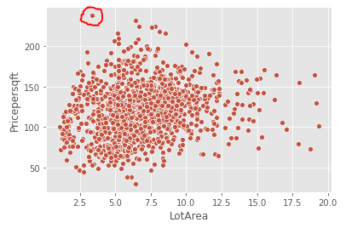
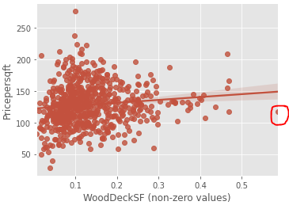
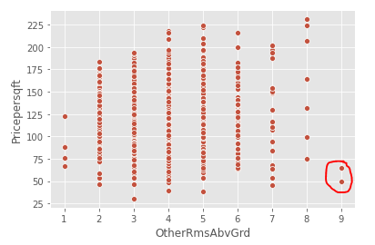
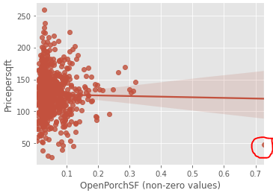
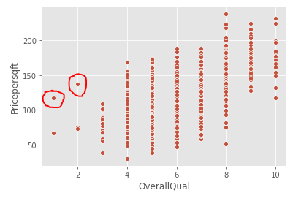
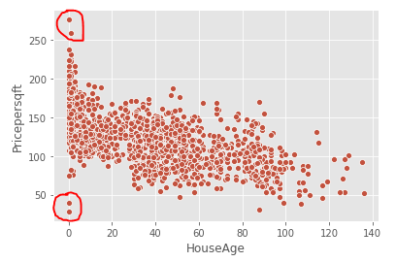
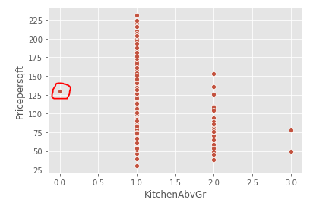
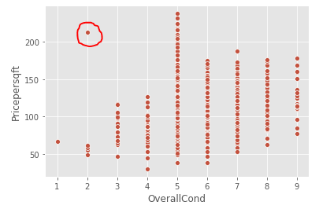
3) Data cleaning: outliers
OpenPorchSF
Drop 1 record (Abnormal SaleCOndition) had value >70% of GrLivArea
WoodDeckSF
Drop 1 record that had value >50% of GrLivArea
MiscFeature
Drop 1 record that had tennis court
Drop 2 records that had ‘Othr’ (no explain)
Drop 2 records that had ‘Gar2’
LotArea
Drop 20 records that had lot sizes that are 20 times greater than GrLivArea
Such large lot sizes are likely special cases
HouseAge, OverallCond, OverallQual and SalePrice
Drop 4 records where house age is 0 or 1 year and SalePrice / GrLivArea is greater than 250 and less than 50
Drop 1 record where condition is 2 and SalePrice / GrLivArea > 250
Drop 2 records where quality < 3 and SalePrice / GrLivArea > 100
Drop 1 record with 8 bedrooms
Drop 1 record with 0 kitchens
Drop 2 records with 9 other rooms
Linear models (without regularization) are sensitive to outliers

Slide 7
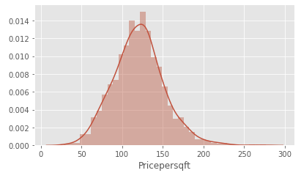
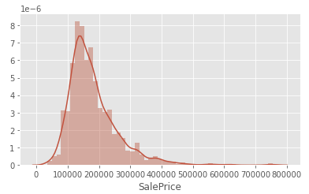
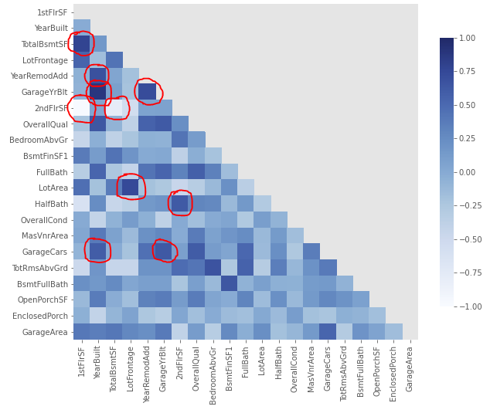
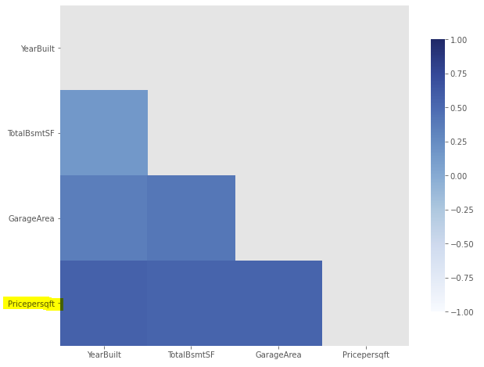
4) Data exploration
34 numerical and 45 categorical
Highly skewed distributions (>9): MiscVal, PoolArea, LotArea, 3SsnPorch, LowQualFinSF (due to many zeros)
SalePrice
Use GrLivingArea to create ‘Pricepersqft’ (which is much closer to normal distribution)
All area variables
Divide all area variables by GrLivingArea, which brings comparability and standardisation benefits
Features correlated with Pricepersqft
Surprisingly YearBuilt, TotalBsmntSF, GarageArea are demonstrating >50% correlation
Multicollinearity is going to be a problem
Top10 pairs are >90% correlated
58 pairs are greater than 70% correlated
Most correlations make sense, e.g. 1stFlrSF/2ndFlrSF, YearBuilt/GarageYrBult, TotalBsmtSF/1stFlrSF, LotFrontage/LotArea, YearRemodAdd/GarageYrBlt

